Slide 1


CPS 109 Lab 8
Gurpreet Kaur
Mojan Nooshin Habibi

Slide 2


Agenda
Quiz 6 Discussion
Quiz 7 Discussion
File Handling in Python
Quiz 8

Slide 3
Python : File Handling
Python provides several ways to manipulate files.

Slide 4
Opening a file
Python Provides the open() function to open a file.
It takes 2 arguments : name of file , Mode in which file should be opened .
‘r’ – Reading
‘w’ – Writing
‘a’ – appending
Note : By default , open() returns a file object that cane be used to read from or write into file (depending on mode)

Slide 5
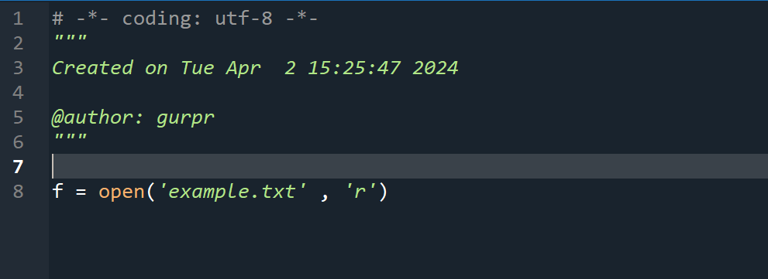
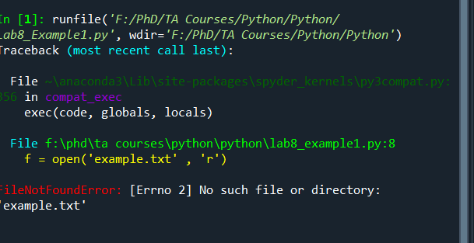
Example 1

Slide 6
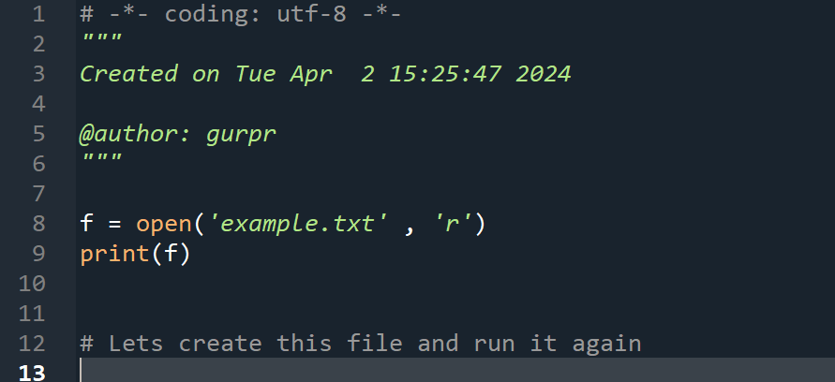
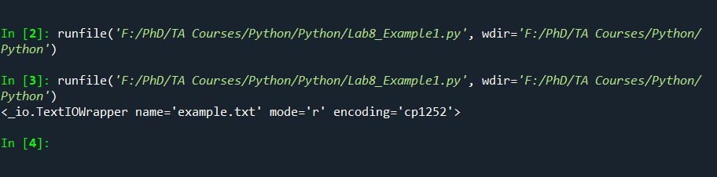
Explore ..

Slide 7
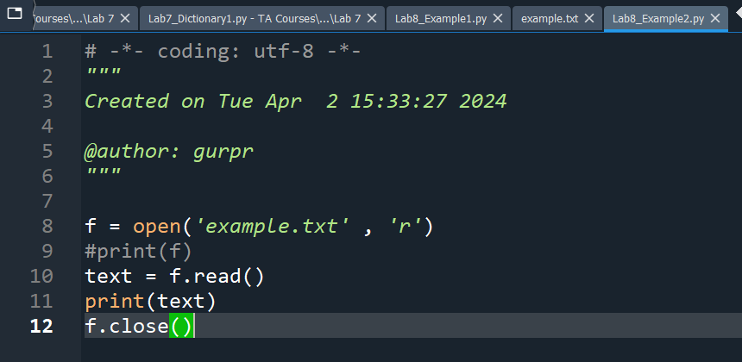
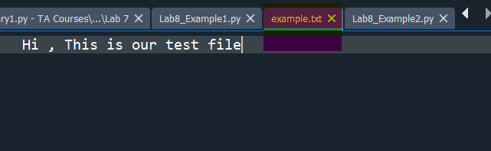
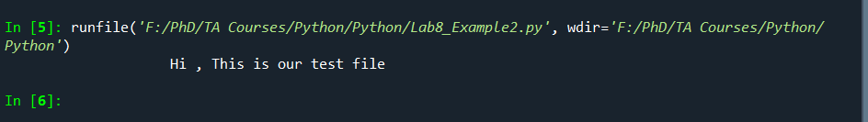
Lets see .. Another example

Slide 8


Modes In file
Read ( r) : This mode opens for reading only and generates error if file does not exist. This is the default mode if no mode is passed as parameter
Write (w) : open for writing only and creates a new file if file does not exist
Append(a) : opens the file for appending only and creates a file if file does not exist
Create(x) : creates a file and gives an error if the file already exists
Text(t) : it is used to handle text files . T refers to the text mode . The default mode is ‘r’ (similar to text)
Binary(b) : used to handle binary files ( images , pdfs etc)

Slide 9
Reading from a file
The read() method reads the entire contents of the file and return as a string
(Example2.py)

Slide 10
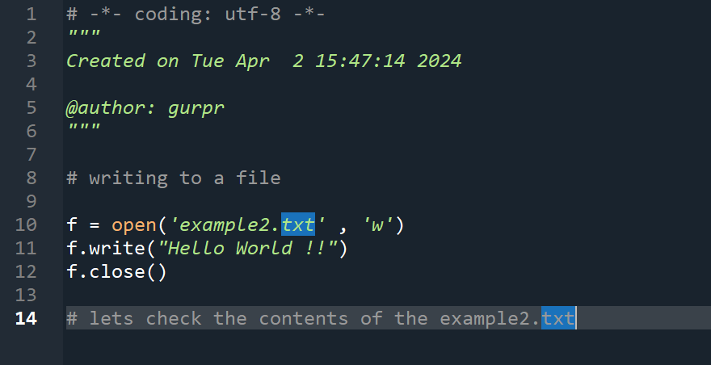
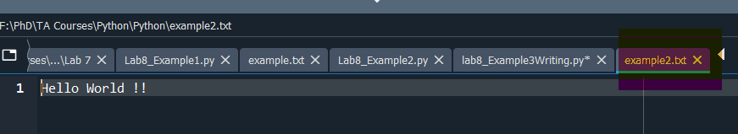
Writing to a file

Slide 11
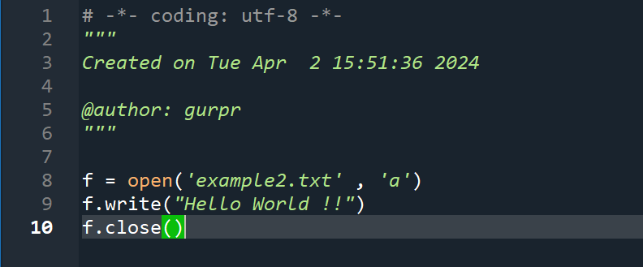
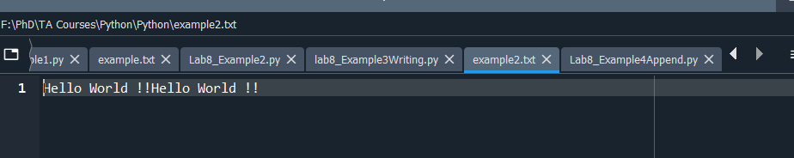
Appending a file

Slide 12
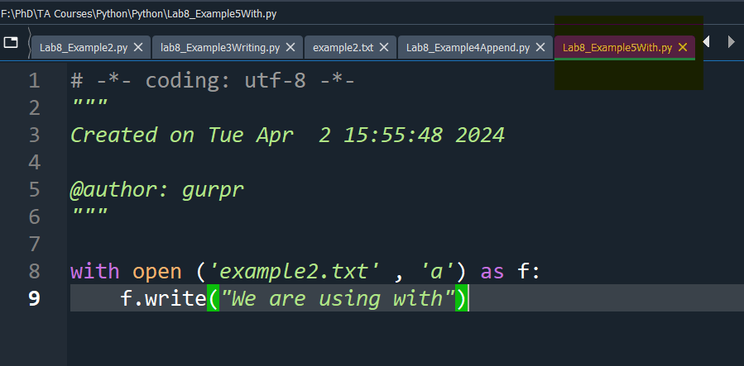
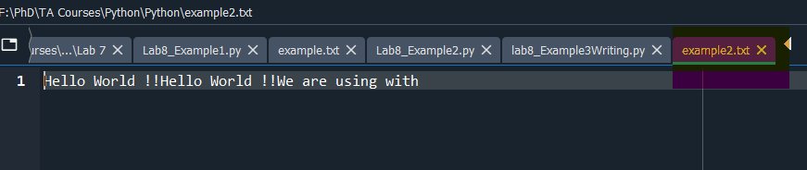
The ‘with’ statement
Alternatively , we can use ‘with’ statement to automatically close the file once we are using the file.

Slide 13
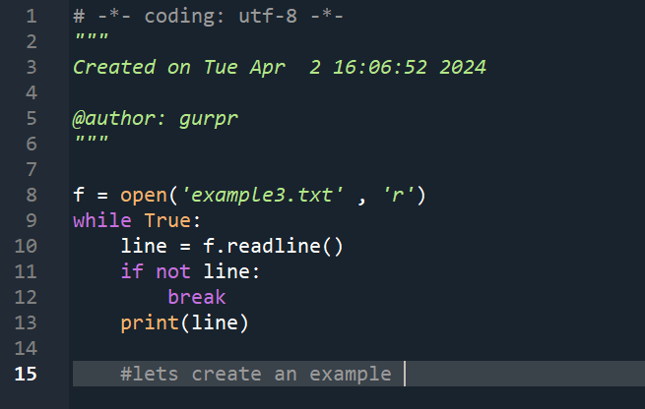
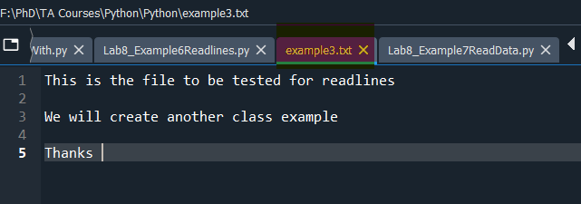
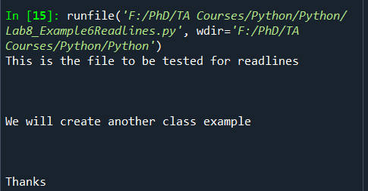
Readlines() method

Slide 14
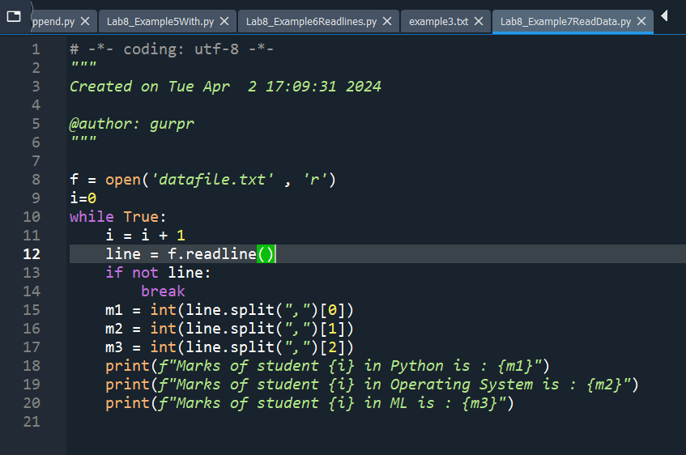
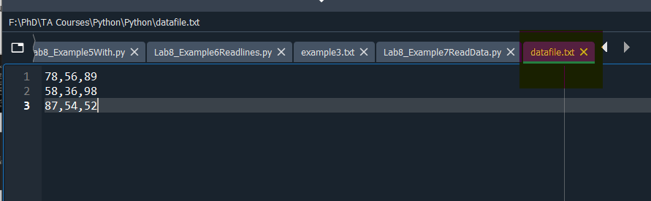
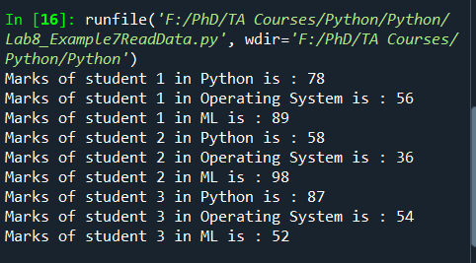
Data Reading : Example7ReadData.py

Slide 15

Writelines() method
Writelines() method writes a sequence of strings to a file . The sequence can be any interable object such as list or a tuple

Slide 16
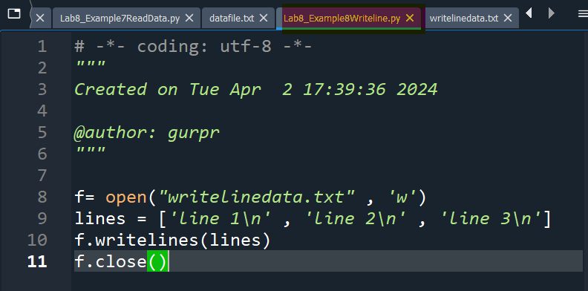
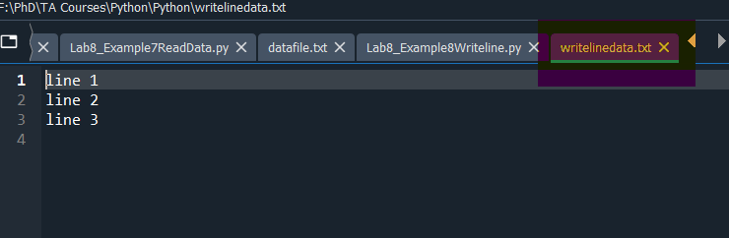
Example8

Slide 17

Thanks !!!
Any Questions?

Slide 18
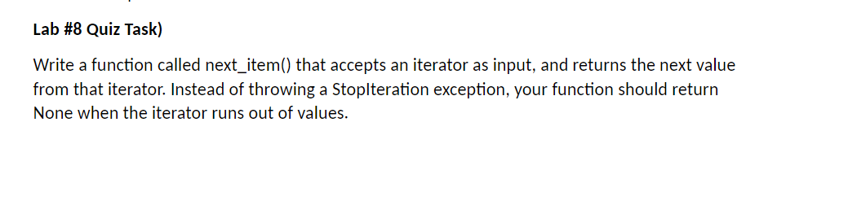
Quiz Time

